Slide 1
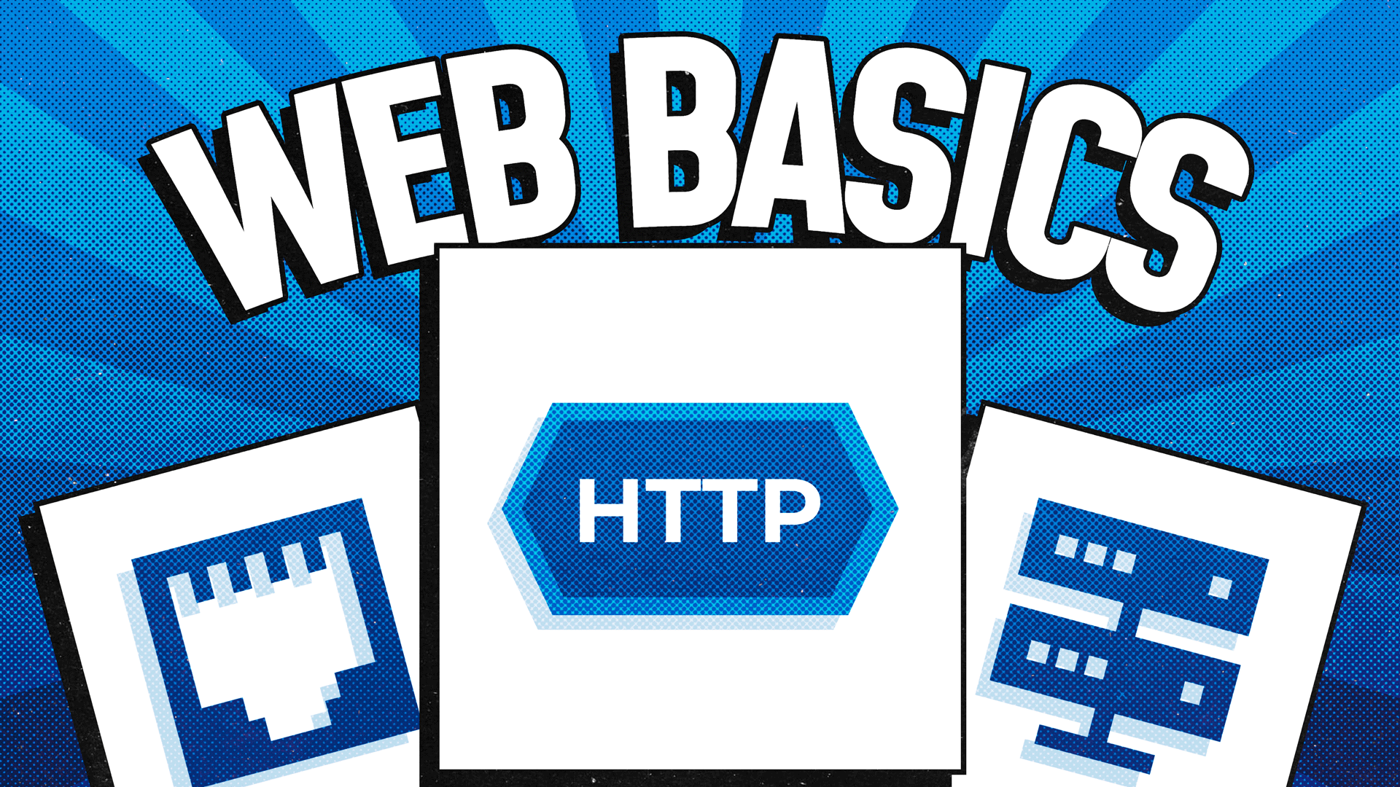

Slide 2
Сървър
Kомпютър, стартиращ сървърен софтуер предоставящ услуги като например хост (предлага информационни ресурси (HTML,снимки,текст и много други) за потребители в интернет);
Компютърна програма, която стартира като услуга, която обслужва заявки на други програми („клиенти“). Той слуша за заявки (request) и връща отговор (response), като и двете операции са по предварително зададен протокол;
Завършена софтуерна система например сървър база данни, файлов сървър, mail сървър;

Slide 3
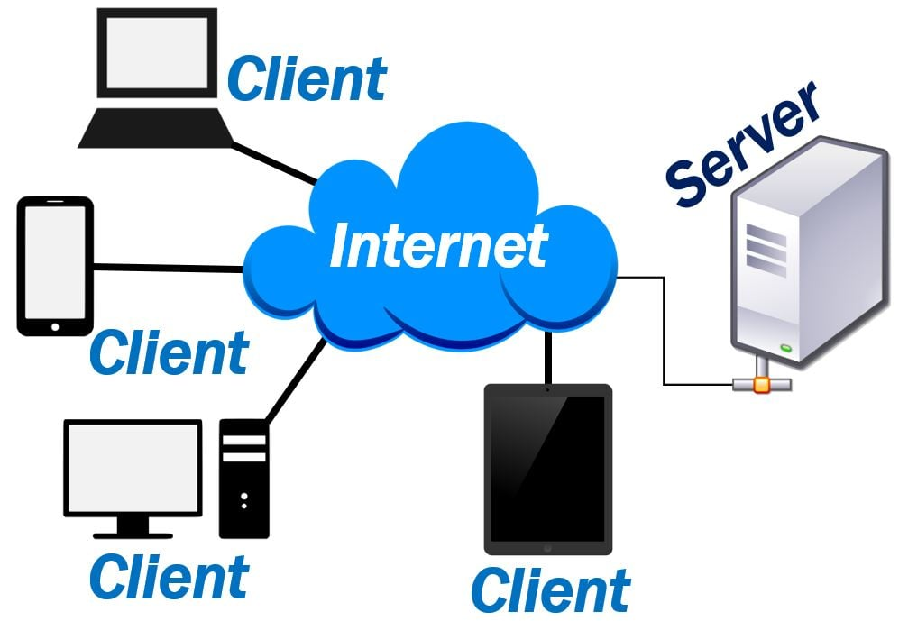

Slide 4
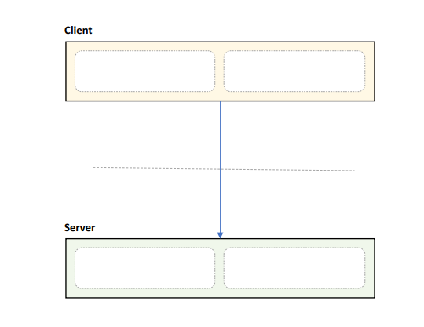
Client/Server Pattern – Layered
Distinct client and server
Separated by network
Communication protocol
Many clients, one server
Pros:
Secure & Simple
Centralized Control
Easy to manage
Cons:
Requires network, difficult to scale
Single point of failure
4

Slide 5
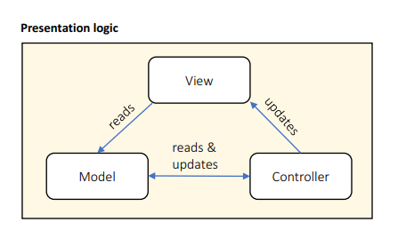
MVC Pattern
Designed for presentation layers
View handles output
Model handles data
Controller handles interaction
Pros:
Strict separation of concerns
Scales well
Cons:
High overhead
Scattered code
Hard to data-bind
5

Slide 6
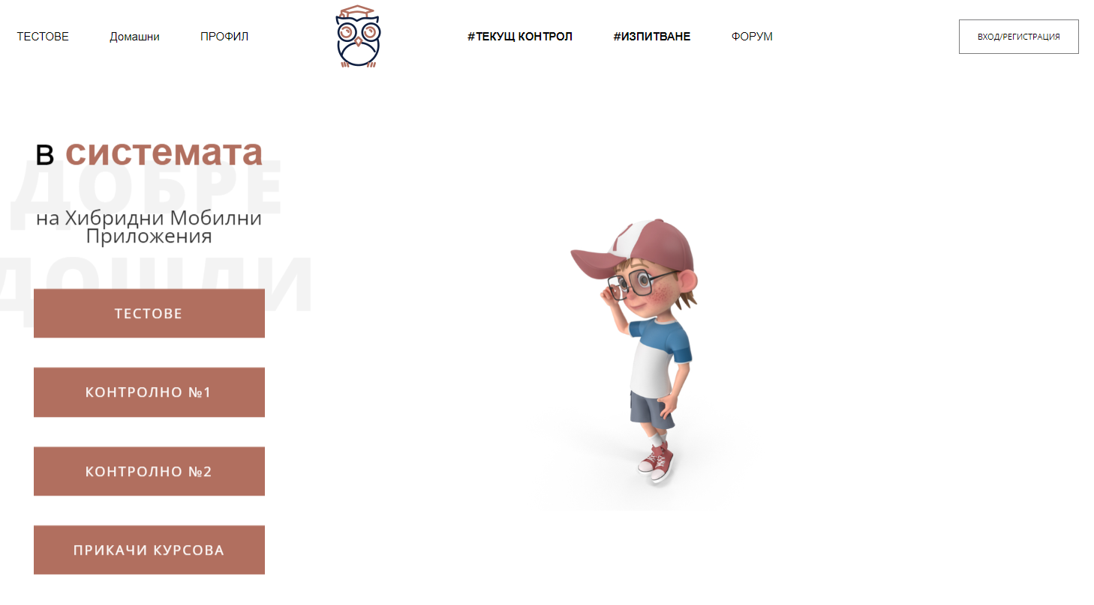
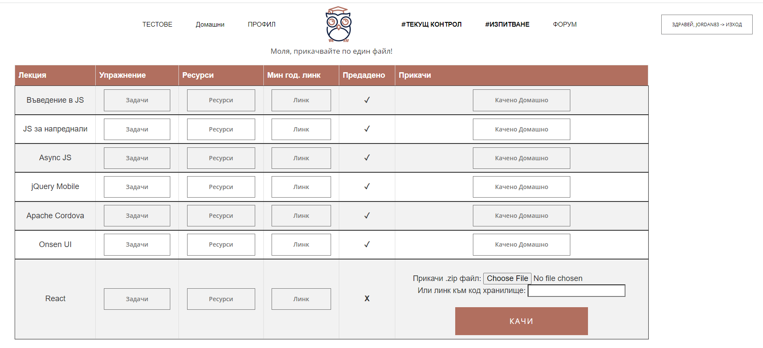
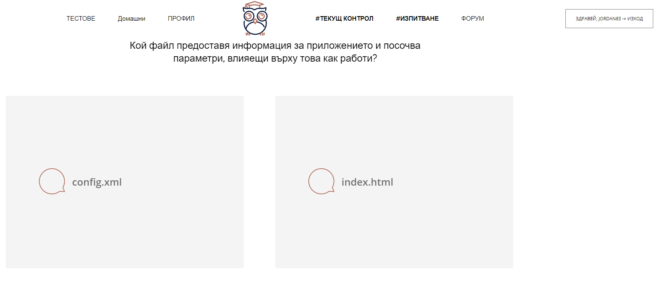


Students manager
Клиент е браузърът на текущия потребител
Уеб приложение, хостнато на уеб сървър
www.manager.com
HTML, CSS, JS, Pictures…
www.manager.com/Tests
HTML, CSS, JS, Pictures…

Slide 7
Single-Page Application
Взаимодейства с потребителя чрез динамично пренаписване на текущата уеб страница с нови данни от уеб сървъра, вместо да пре-зарежда цели нови страници. Целта е по-бързи преходи.
Клиент е отделно приложение, изпълняващо в браузъра на текущия потребител
Уеб приложение, хостнато на уеб сървър
www.manager.com
HTML, CSS, JS, Pictures…
www.manager.com/Tests
JSON
www.manager.com/bot
JSON

Slide 8
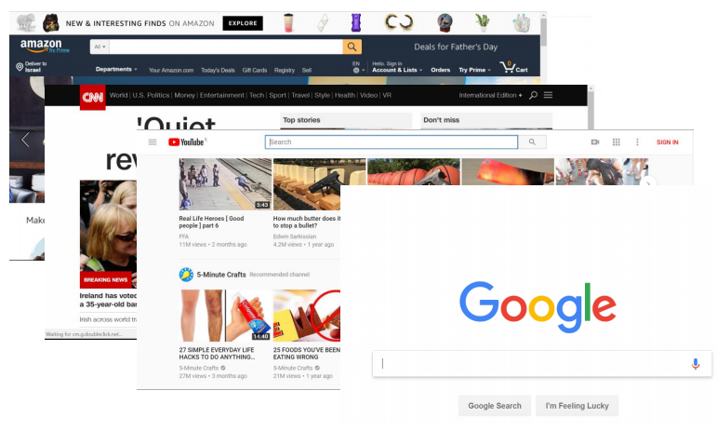
Application Types – Web application
Best suited for:
User interface
User initiated actions
Large scale
Short, focused actions
Request-Response based

Slide 9
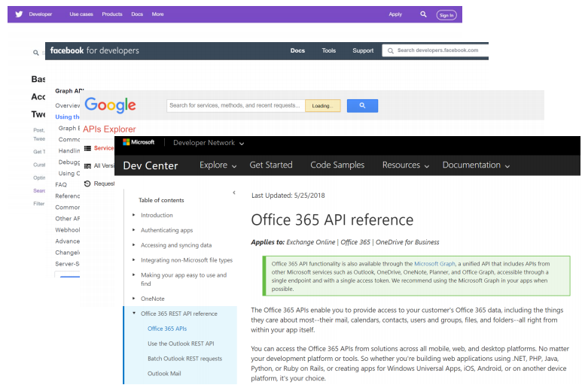
Application Types – Web API
Best suited for:
Data retrieval and storage
Client initiated actions
Large scale
Short, focused actions
Usually REST based
Returns data, not HTML
Combination of:
URL (https://www.mysite.com/api/orders)
Parameters (date=10/10/2017)
HTTP Verb (GET)

Slide 10
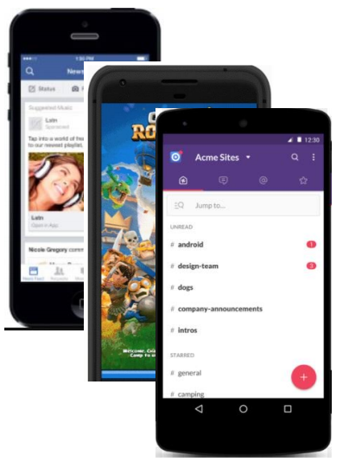
Application Types – Mobile Application
Best suited for:
Well, mobile devices ☺
User interaction (games, social apps)
Front end for Web API
Location & camera-based systems
Usually work with a Web API

Slide 11
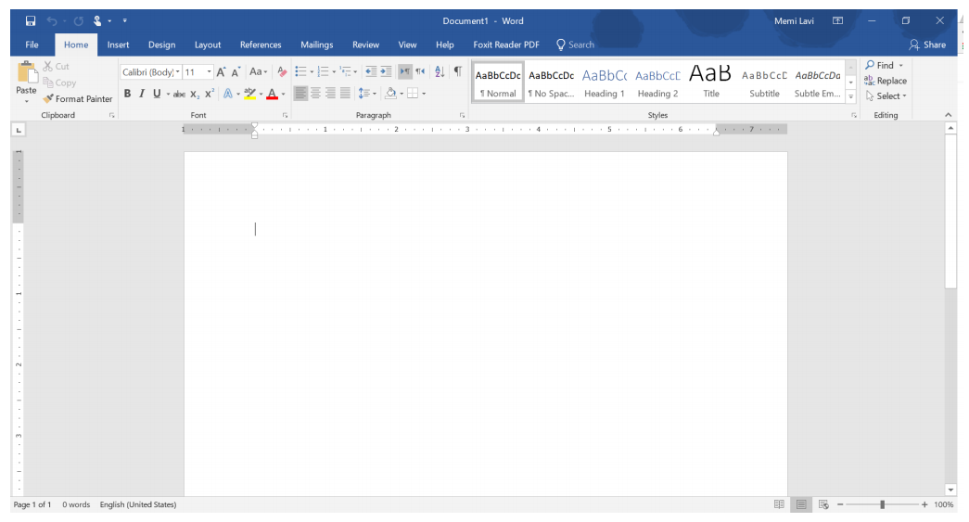
Application Types – desktop Application
Best suited for:
User centric actions
Gaming
Has all its resources on the local PC
Might connect to the web
Great UI

Slide 12
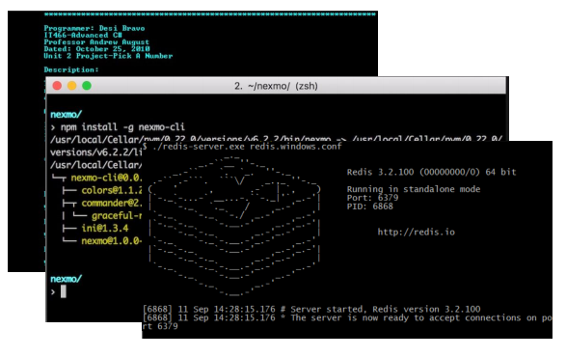
Application Types – Console Application
Best suited for:
Long-running processes
Short actions by trained power-users
No fancy UI
Require technical knowledge
Limited interaction
Long or short-running Processes

Slide 13
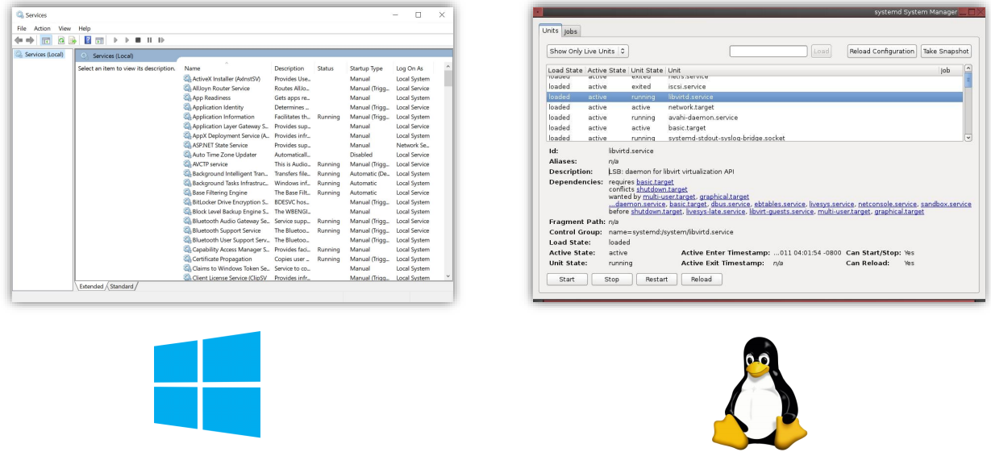
Application Types – Service
Best suited for:
Long-running processes
No UI at all
Managed by the OS service manager

Slide 14
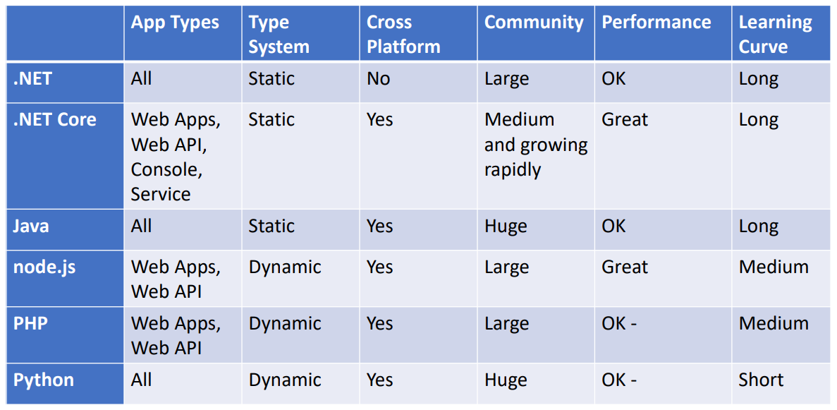
Back-end and service Technologies

Slide 15
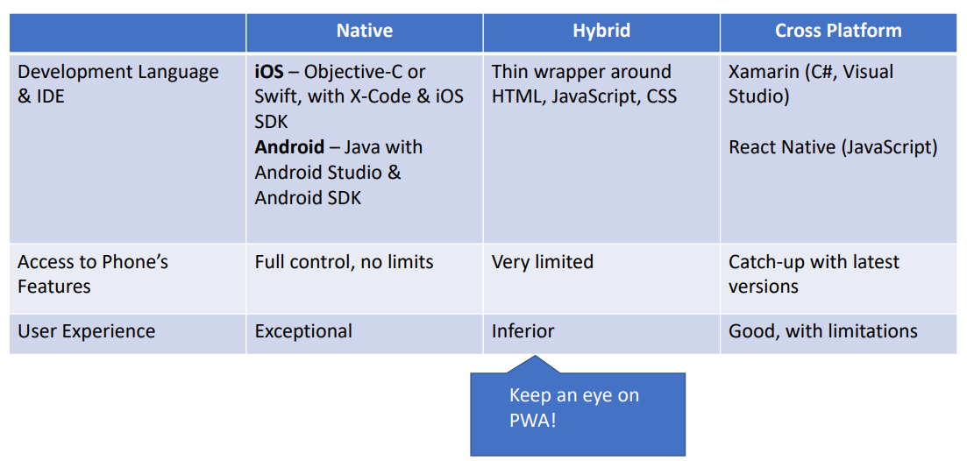
Mobile technologies

Slide 16
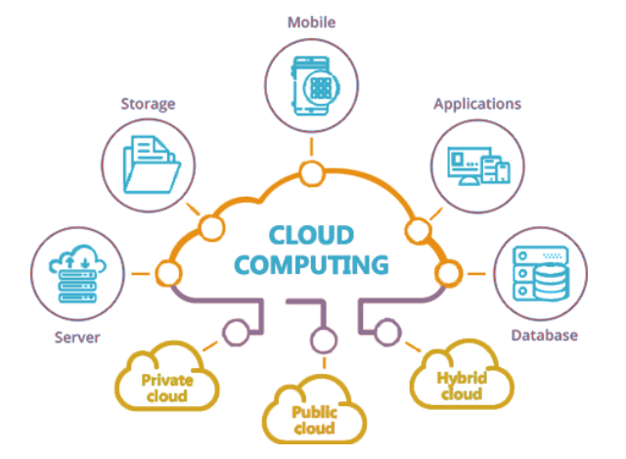

Slide 17

Технологиите, базирани на облак, дават възможност на организациите да създават и изпълняват приложения в модерни, динамични среди като публични, частни и хибридни облаци, чрез мрежи от услуги и микроуслуги. Качества на системите са устойчивост, висока наличност и достъпност, мащабируемост и управляемост, които са от критично значение за много от бизнес единиците. Автоматизацията на тези процеси позволява на инженерите да правят промени, с голямо въздействие, но с минимални усилия

Slide 18
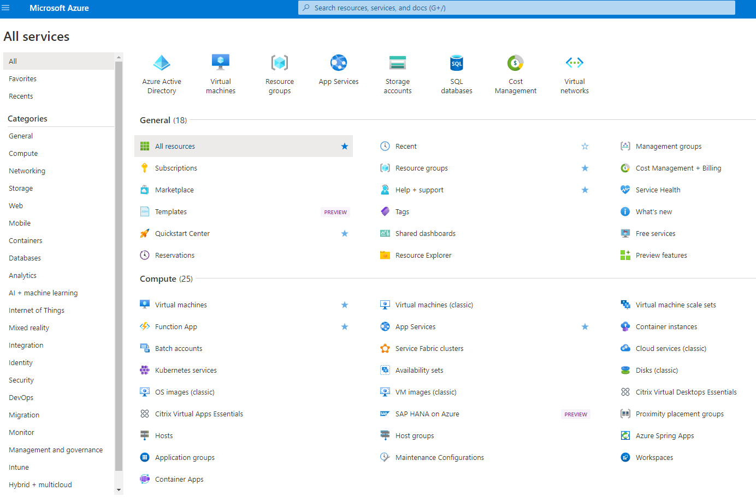

Slide 19


Slide 20
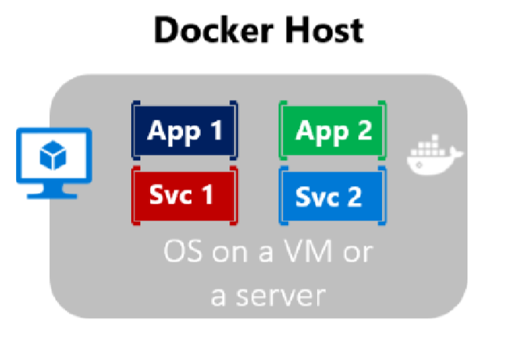
Containerization
Approach in which an application or service is packaged as an image
With its dependencies and configuration
The containerized application can be tested and deployed as a unit to the host OS
Allows deployments across environments with little or no modification
Containers also isolate applications from each other on a shared OS
The containers runs on a container host
The container host runs on an OS (Linux or Windows)
Thus having a smaller footprint than virtual machines

Slide 21
What is docker?
Docker is lightweight, open, secure
It simplifies building, shipping, and running applications
On different environments
Runs natively on Linux or Windows servers
Runs on Windows or Mac development machines
Relies on "images" and "containers"
The playground is a good starting point:
https://www.docker.com/play-with-docker

Slide 22
What is docker?
Image
An image is just like a blueprint
A read-only template
Contains the building blocks of an application
Framework, dependencies and code are "described" here
Container
Built from the image
It is the actual running environment for your application
Isolated and secured
It can be started, stopped, moved, and deleted
You create a container for your different application pieces
Database, Presentation, Caching, etc.

Slide 23
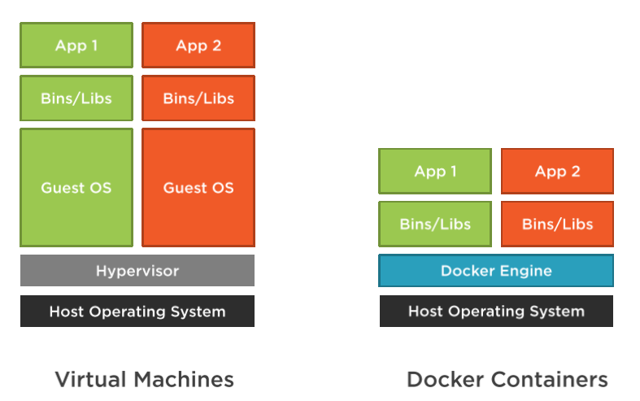
Docker VS Virtual Machines

Slide 24
Docker VS Virtual Machines
Virtual Machines
Have a guest OS, which is heavier
Images are bigger in terms of size
Slower startup time
Everything is a copy of the host OS
Docker
No guest OS, just a process
Images are small in terms of size
Fast startup time

Slide 25
Benefits for web developers
Accelerating developer onboarding
Eliminate application conflicts
Isolated containers
Environment consistency
If it runs on development environment, it should run on the staging/production
Ship software faster
Updating and migrating software is very easy

Slide 26
Docker Tools
Docker Desktop
Runs on Windows or Mac development machines
Includes Docker Engine, CLI and Kubernetes
Containerize and share any application
Complete Docker development environment
On Windows
Ability to switch between Linux and Windows Server environments
Supports Pro, Enterprise, and Education versions
For Home – you can only run Linux containers through WSL 2
There are third-party solutions for Linux – DockStation, CairoDock, and more…

Slide 27
Docker Tools
Docker Hub
Cloud-based application registry
Development team collaboration services
Supports public and private repositories
The world’s largest library of container images
Automated builds and webhooks
https://hub.docker.com/

Slide 28
DEMO

